Slide 1


Webinar /
01
Intro to ASP.NET Core Apps Development with Raspberry Pi

Slide 2





José M. Nieto Senior .NET Developer
J
@superjmn
/superjmn
jnieto@bravent.net

Slide 3
A
Agenda
Installation of Rasbian in Raspbery Pi
Standard method
Headless method
Installation of additional packages
Installation of .NET Core
Creation of .NET apps
Basic application ASP.NET Core
Manual deployment
Automated deployment (using template)
EXTRA: Working with the GPIO port
Notes:
Objective:
Every company is a software company, relying on technology to differentiate, compete and thrive.
Key talking points:
Companies you already know, such as Uber, Netflix, Facebook, were either born in the cloud, or have adopted the cloud to drive business growth. These companies move faster, deliver more value, and meet our ever-changing needs more effectively than those constrained by rigid policies and processes.
They found new ways to use the flexibility of the cloud to their advantage. They designed ways to scale out nearly infinitely and gain deeper insights into their customers that other companies could only dream about.
[Speaker Guidance: Be aware that for many audience members these are likely to be far removed from their experience to not be even ‘aspirational’. Use this slide as a setup for the next, rather than as a goal for the current attendees to seek right away. They’re just too far advanced in the DevOps arena. Plus, they are so focused on software – their entire business is software – that they have the resources to build their own ‘PaaS-like’ infrastructures internally on IaaS style equipment. Attendees shouldn’t seek to mimic these companies yet.
Use this slide to talk the benefits in the talking points, but don’t go overboard, the true motivators are on the next slide.]
------
What do these images have in common? They are all existing BIG industries that were disrupted by born in the cloud companies.
These companies - Uber, Netflix, Skype, Amazon – took advantage of the cloud – scale, flexibility, economics / new business models to completely change these industries.

Slide 4
Installation of Raspbian
We need
A Raspberry Pi!
MicroSD card (“HC Class 10” recommended)
A PC to carry out the installation (we’ll ver using Windows)
With card reader for microSD
Network connection (Wi-Fi or LAN)

Slide 5
Raspbian Download
Go to the official Raspberry Pi website
Here’s the download URL:
https://www.raspberrypi.org/downloads/raspbian/
There are 2 versions
Download the desktop version, it’s easier for beginners (like me ☺)
The image comes compressed inside .ZIP file.
Once the file is downloaded, open it and extract the content to a folder we have in hand. For example, on the Desktop.

Slide 6
Image Recording
To write the image we will use the Win32 Disk Imager tool
You can download it from:
https://sourceforge.net/projects/win32diskimager/

Slide 7
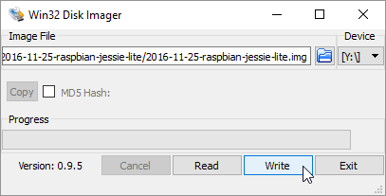
Image Recording
It’s very easy to use:
Start the application
Select the Raspbian image (.img file)
Select the drive corresponding to the MicroSD card
Select “Write” and wait until the image has been written (it’s a long process)

Slide 8
Connection and starting Raspian
To access our Raspbian installation we have 2 options:
Standard installation
“Headless” installation (No keyboard, mouse or screen needed)

Slide 9
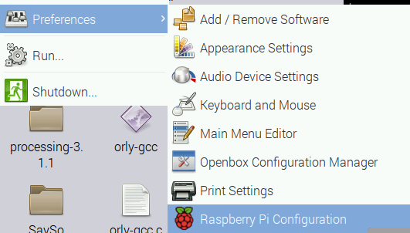
Standard
1. Remove the card and put it in the Raspberry Pi MicroSD slot
2. Connect a mouse, a keyboard and a display (USB and HDMI ports)
3. Plug the power cord to the Pi to turn it on
4. Wait until the desktop is shown.
5. Go to the Raspberry Pi configuration application

Slide 10
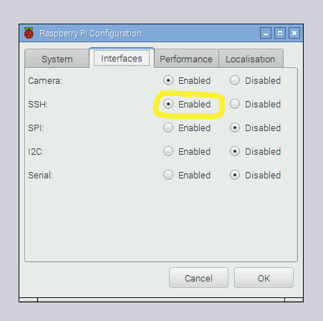
Standard
In the interfaces tab
Choose SSH option and set it to “Enabled”

Slide 11
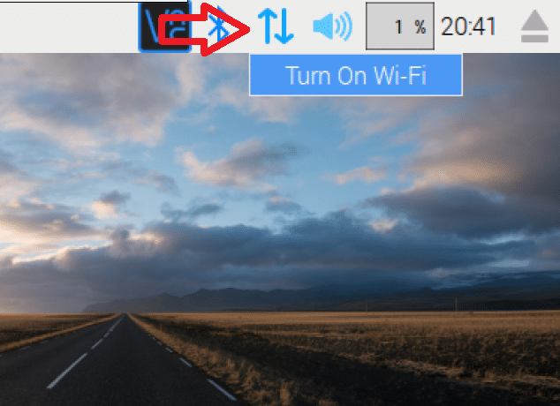
Standard
Connect it to your local network
Wi-Fi: Connect to your Wi-Fi network using the upper bar icon (the one in with the two arrows)
LAN: Of course, if you decide to use a LAN cable, you can do it, too.

Slide 12
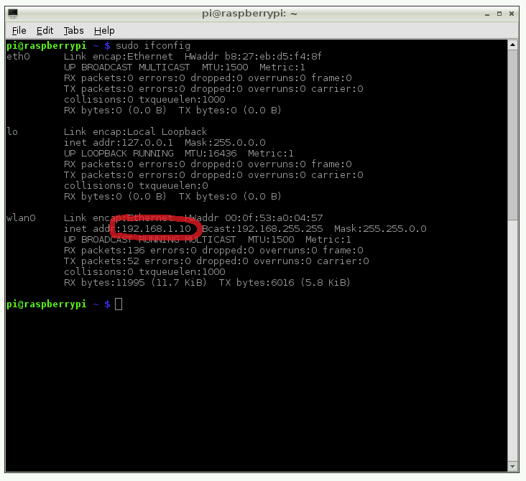
Standard
WE NEED TO KNOW OUR IP
So..
Open a terminal console Write the ifconfig command
Depending on the type of your connection, Wi-Fi or LAN, we need to look in eth0 or wlan0

Slide 13
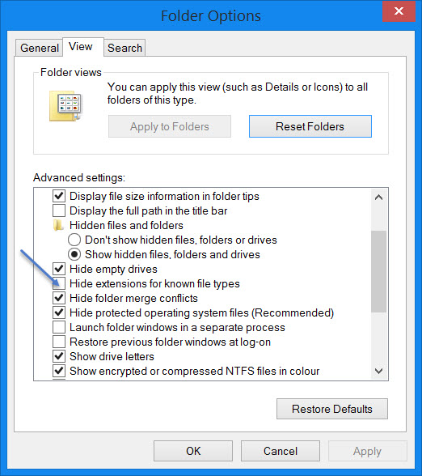
Headless
If we don’t want to connect a display, keyboard or mouse to configure the Raspberry Pi, we can use this method Lets get started!
Instead of taking out the MicroSD card like we did before, leave it in, because we are going to modify its content.
Open File Explorer
Find a drive letter labeled as “BOOT” and open it
Create a file called “ssh” without extension
Right click
“New text file”
Put the name as “ssh” and delete .txt extension.
* Remember to disable the File Explorer option “Hide extensions…”

Slide 14
Headless
Now we’re going to do the same, but this time we’ll create a text file named “wpa_supplicant.txt”
Right click
“New text file”
Put the name as “wpa_supplicant.txt”.
Open it and paste this text inside the file:
trl_interface=DIR=/var/run/wpa_supplicant GROUP=netdev
update_config=1
country="your_ISO-3166-1_two-letter_country_code"
network={
ssid="your_SSID"
psk="your_password"
key_mgmt=WPA-PSK
}
5. Save it

Slide 15
Headless
Finally, change the name of the file to:
“wpa_supplicant.conf”
Now, take out the MicroSD card and insert it into the Raspberry Pi.
Wait about 90 seconds for it to boot properly.
We can find out the IP in which the Raspberry Pi has been connected (automatically, hence the “headless” name).
To discover the IP, we can use an app called Angry IP Scanner
http://angryip.org/download/
Install and run the application
Press the “Start” button
Wait for the scan to finish

Slide 16
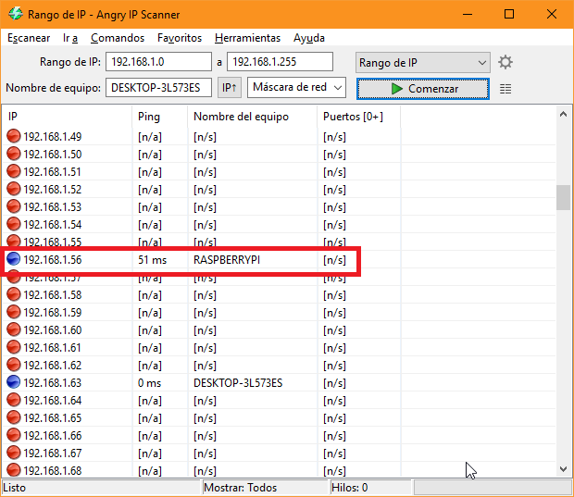
Headless
Specify a range of IP addresses appropriate to your local network.
Normally it is from 192.168.1.1 to 192.168.255
In the addresses where there’s a response (blue circle) we should see our Raspberry listed, as in the image.

Slide 17
Connection to Raspberry Pi
Now that we have the IP address we can connect to our Raspberry PI through the SSH protocol.
Windows does not come with any SSH client by default, but we can use a very popular and free one called
PUTTY
https://putty.org/

Slide 18
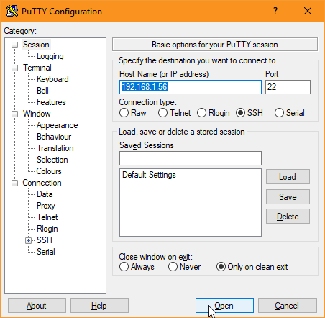
Connection to Raspberry Pi
We see this screen when starting the app. We put the IP of our Raspberry and leave the rest as it is
We press “Open” and an SSH terminal is opened

Slide 19
Connection to Raspberry Pi
It will ask us for our user name and password
Default login:
Username: pi
Password: raspberry

Slide 20
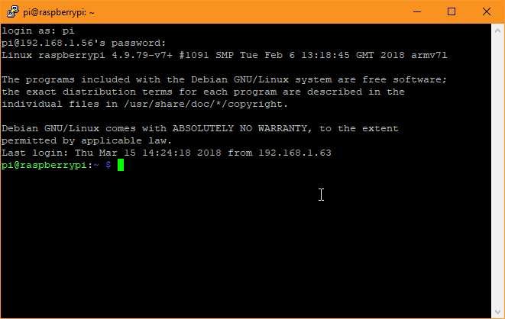
Connection to Raspberry Pi
Once we’re inside we can see the a command prompt.
We’ve successfully connected to our Raspberry Pi from our computer!

Slide 21
Samba Installation
Samba is a service that allows us to share files through the network with Windows devices, among others.
It will be very useful to you, for example, to deploy apps or to check execution logs.
It’s worth enabling this service.

Slide 22
Samba Installation
To install and activate it we have to write the following commands in the terminal
> sudo apt-get update
> sudo apt-get install samba samba-common-bin
Samba will then be installed.
Now we have to edit a file to configure it
> sudo nano /etc/samba/smb.conf

Slide 23
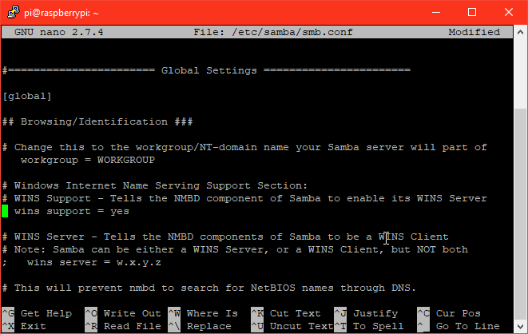
Samba Installation
We have to uncomment (remove the #) from the WINS line and put the name of our workgroup (usually WORKGROUP)
WINS
Set wins support = yes

Slide 24
Samba Installation
WORKGROUP

Slide 25
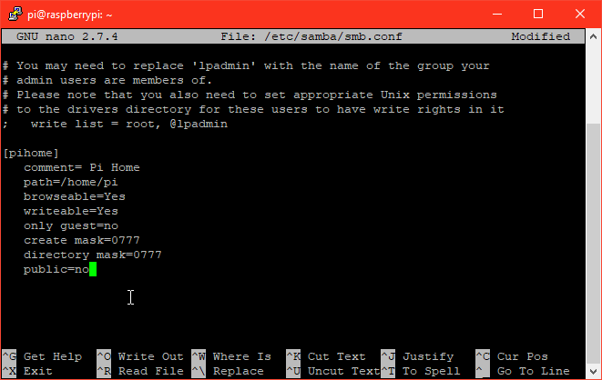
Samba Installation
Finally, we have to create a share resource through a configuration section.
At the bottom of the file, put the following entry
[pihome]
comment= Pi Home
path=/home/pi
browseable=Yes
writeable=Yes
only guest=no
create mask=0777
directory mask=0777
public=no

Slide 26
Samba Installation
Save the file (pressing Control+X, it will ask us to save it)
Finally, we need to put a password that relates our user to the shared resource, in order to protect it.
To configure a password for our login, we will have to execute this command
> sudo smbpasswd -a pi (has to be different from default password)
It will ask us to enter the password
Samba is configured!
We don’t need to restart to access files, although we can do it anyway to be sure.

Slide 27
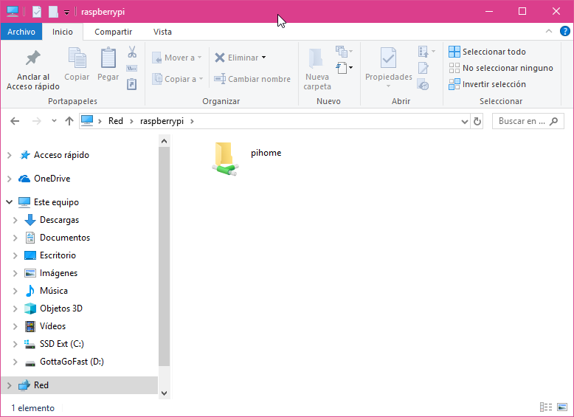
Samba Installation
Here’s the Shared Resource

Slide 28
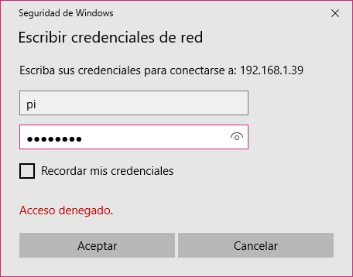
Samba Installation
Double click it and Windows will prompt for the username and password
The user is "pi"
The password is the one that we have set previously by using the smbpasswd command

Slide 29
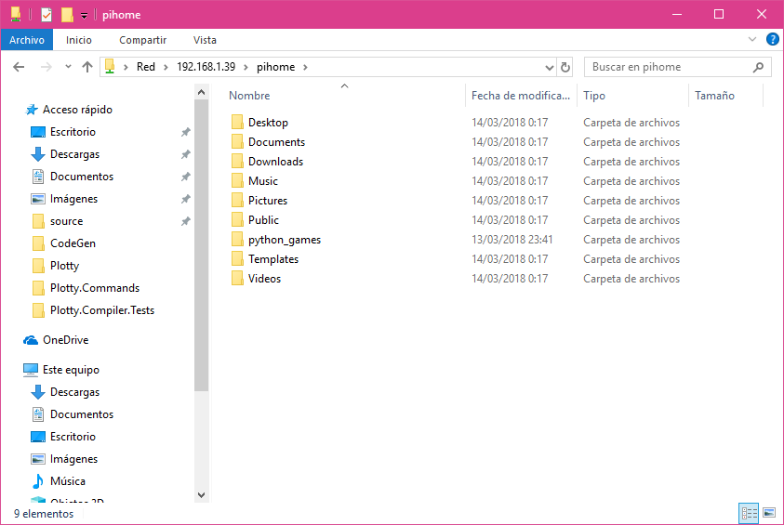
Samba Installation
Once we have done this, we will be able to see the files inside the shared folder

Slide 30
.NET Core installation (runtime)
In order to install thet .NET Core runtime we have to execute the following command in a SSH terminal
sudo apt-get -y update
sudo apt-get -y install libunwind8 gettext
wget https://dotnetcli.blob.core.windows.net/dotnet/Sdk/2.1.403/dotnet-sdk-2.1.403-linux-arm.tar.gz
wget https://dotnetcli.blob.core.windows.net/dotnet/aspnetcore/Runtime/2.1.0/aspnetcore-runtime-2.1.0-linux-arm.tar.gz
sudo mkdir /opt/dotnet
sudo tar -xvf dotnet-sdk-2.1.300-linux-arm.tar.gz -C /opt/dotnet/
sudo tar -xvf aspnetcore-runtime-2.1.0-linux-arm.tar.gz -C /opt/dotnet/
sudo ln -s /opt/dotnet/dotnet /usr/local/bin
To check that we have installed it correctly, we can execute dotnet –Info
Information of our runtime should appear

Slide 31
Creation of .NET Core Applications
Currently, it is already possible to compile the code directly from Rasbpian with the .NET Core 3.0 SDK (still in preview)
However, because it is more convenient to program in the PC, we will generate everything locally in Windows with Visual Studio and later, we will deploy the application to our Raspberry Pi.

Slide 32
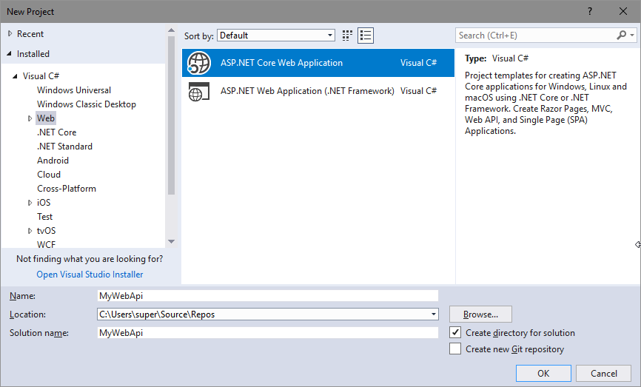
Creation of .NET Core Applications
Let’s create our first app!
Within Visual Studio, create a new ASP.NET Core Web Application

Slide 33
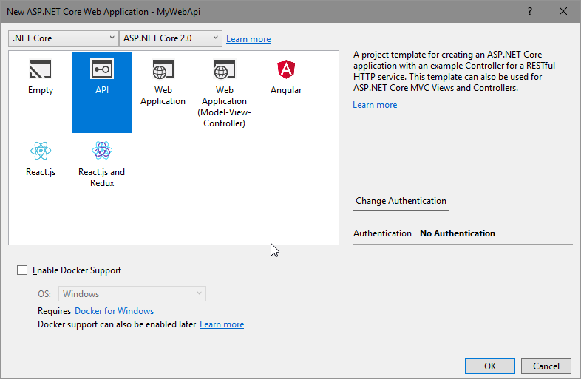
Creation of .NET Core Applications
It will be the default Web API (“API”) from the Visual Studio templates.
Choose API and leave everything with the default settings

Slide 34
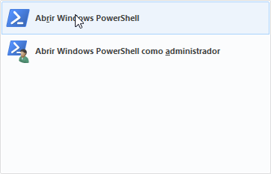
Creation of .NET Core Applications
Once the wizard is finished, we will cross-compile the code using a console command.
- Let's go to the solution folder (.sln)
- Open a console terminal (PowerShell)

Slide 35
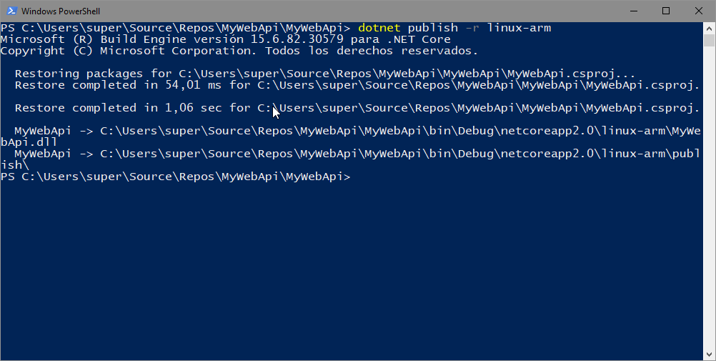
Creation of .NET Core Applications
Execute the following command:
> dotnet publish -r linux-arm

Slide 36
Creation of .NET Core Applications
One it’s finished, the build results will be published inside the folder
\bin\Debug\netcoreapp2.1\linux-arm\publish

Slide 37
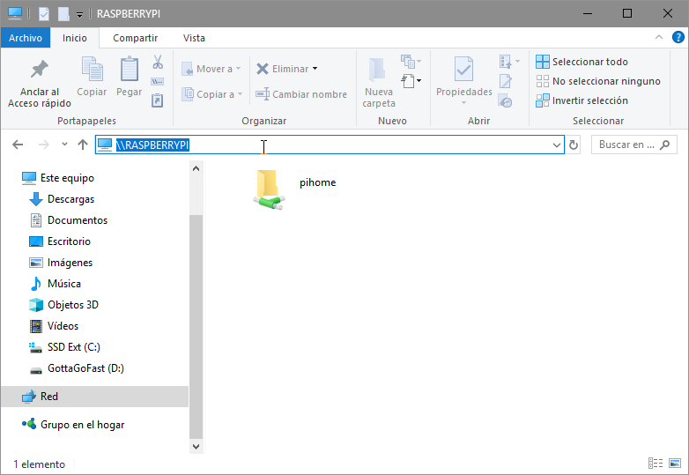
Creation of .NET Core Applications
To deploy to the Raspberry PI, we will do it through Samba
Let’s head to the previously shared folder inside the Raspberry PI
Open file explore and write \\raspberrypi\ in the URL bar

Slide 38
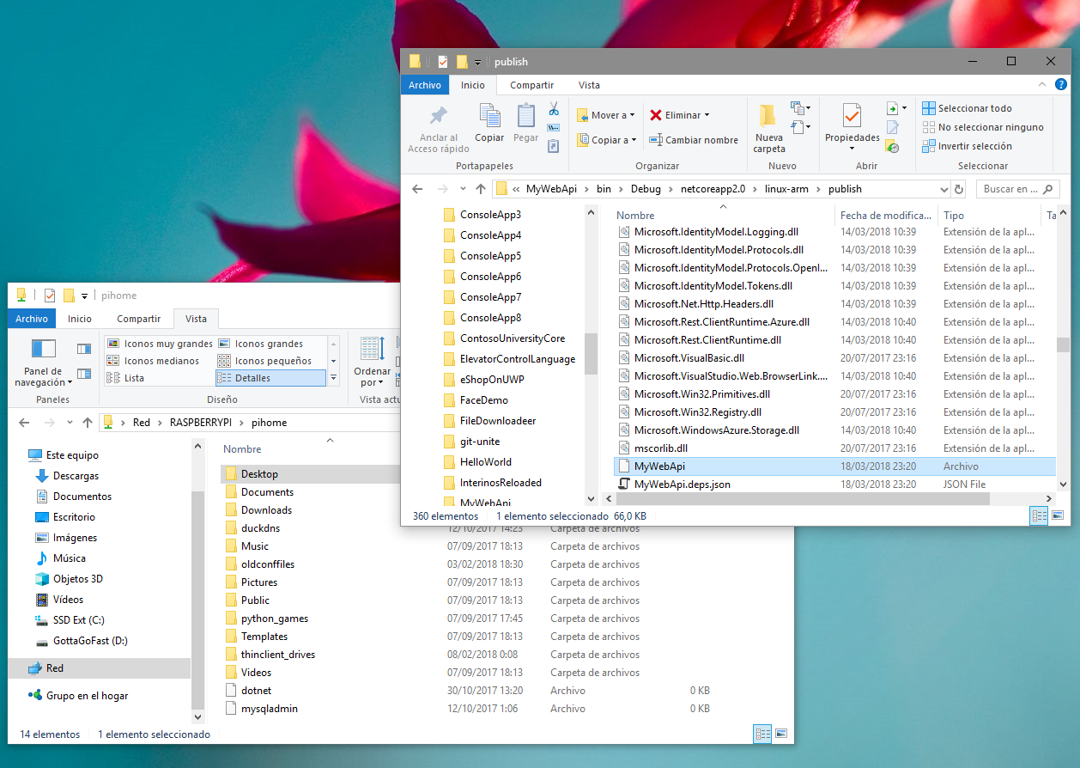
Creation of .NET Core Applications
Now, copy all the files from the publish folder to a folder inside the Pi. For example, to Desktop/NetCore/MyWebApi.
Don’t forget to create the folder first 😃

Slide 39
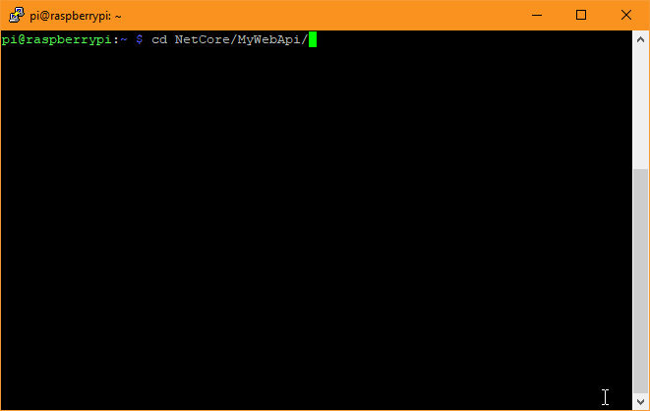
Creation of .NET Core Applications
Now we can start an SSH console and connect to the Raspberry if we don’t already have one open ☺
Go to the folder where we put the files

Slide 40
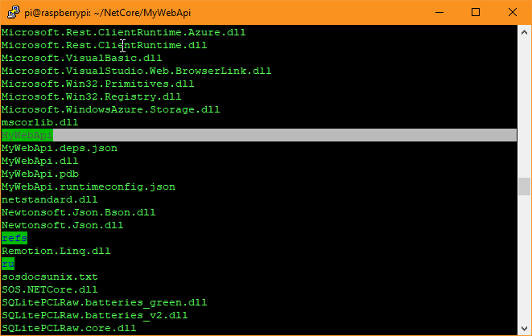
Creation of .NET Core Applications
Now we have to grant the execute permission to the generated executable file
This file has the same as the solution in our case. In addition, it is easy to find it because it has no extension
In the image below we can see the file we are going to grant the execute permission

Slide 41
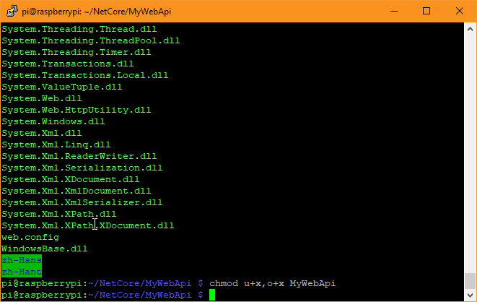
Creation of .NET Core Applications
Execute the chmod command to grant it
> chmod u+x,o+x MyWebApi

Slide 42
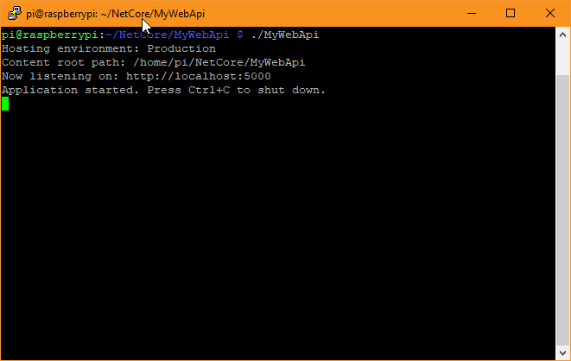
Creation of .NET Core Applications
Now, execute the application using this command
./[executable_file]
In our case ➔ ./MyWebApi
Execution starts and our Web API is already accesible (on port 5000) ☺

Slide 43
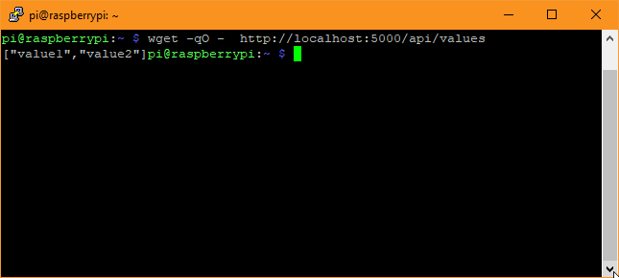
Creation of .NET Core Applications
To check that the server is running we can start another SSH session and run the following command:
wget -qO - http://localhost:5000/api/values
We will obtain the output of the API call
Result

Slide 44
Creation of .NET Core Applications
However, the server will only be reachable from the Raspberry Pi itself since the code that is created by default template only accepts connections from the local host (from the Pi).
To accept outside connections we must modify the code inside Program.cs
namespace MyWebApi
{
public class Program
{
public static void Main(string[] args)
{
BuildWebHost(args).Run();
}
public static IWebHost BuildWebHost(string[] args) =>
WebHost.CreateDefaultBuilder(args)
.UseStartup<Startup>()
.UseUrls("http://*:5000")
.Build();
}
}
This way, we accept every hostname

Slide 45
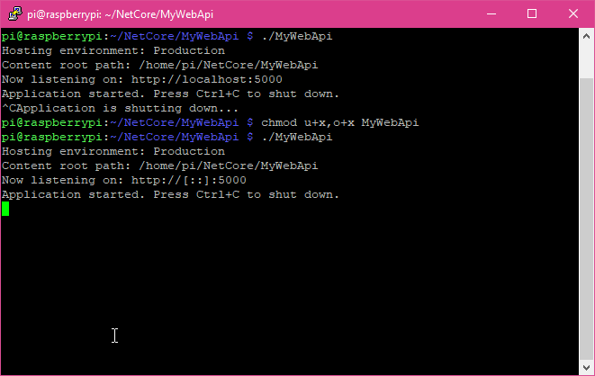
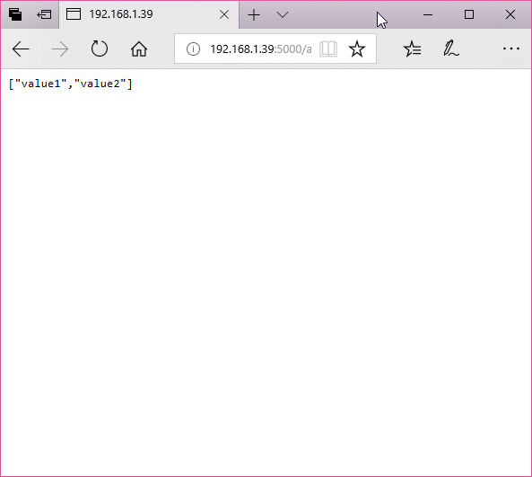
Creation of .NET Core Applications
If we redeploy with this modification again we can access the Raspberry Pi from any browser in the local network
Now, it listens to every request coming to port 5000

Slide 46
Creation of .NET Core Applications
We made it!
But wasn’t the whole process excessively intricate?
Yes, it was! Moreover…
The default app is quite basic
To deploy it we had to do a lot of things
Like… deleting any old files, copying the deployment files, and establishing executable permissions.
Boring and ineffective 😩
Fortunately, we can make things a lot faster and funny. Let’s automatize it!

Slide 47
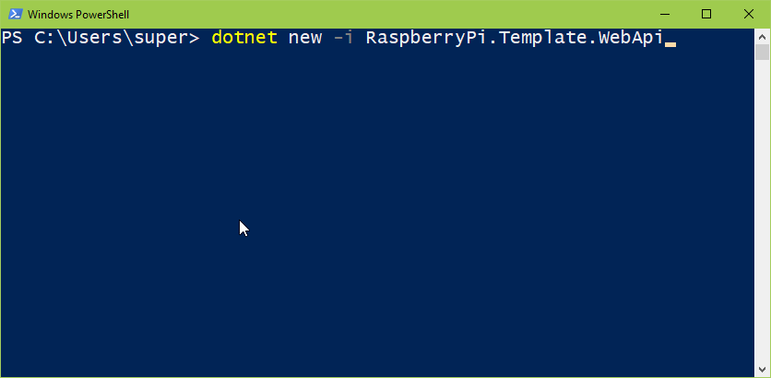
Creation of .NET Core Applications
This is the fast lane!
Let’s use a .NET Core template to make the Web API. No VS needed 😉
To do it, start a terminal and write
> dotnet new -i RaspberryPi.Template.WebApi

Slide 48
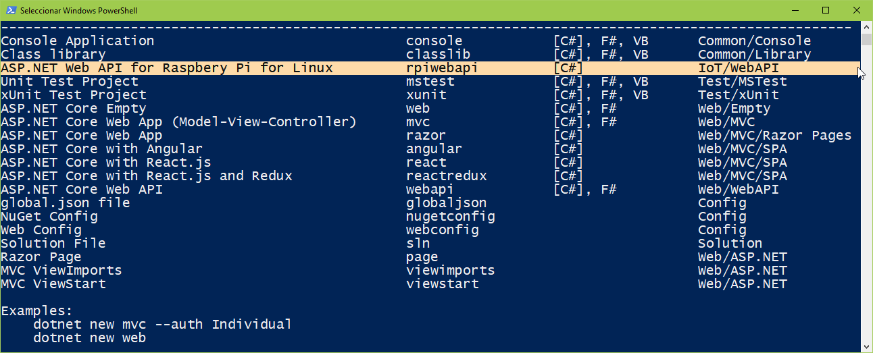
Creation of .NET Core Applications
This will install a special template (from NuGet) that will help you create a Web API application for Raspbian, ready to run and with some cool goodies inside.

Slide 49
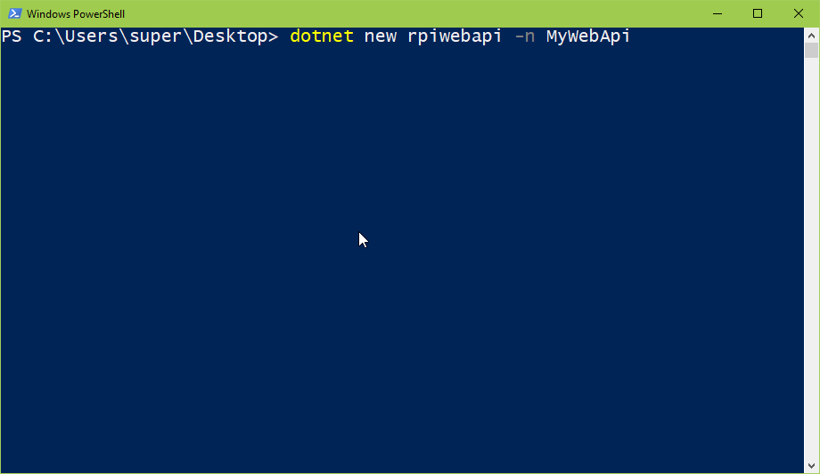
Creation of .NET Core Applications
Now we can create an app with this template
Go to the main file where we want to create our app (example c:\users\[user]\Desktop
Write the command
dotnet new rpiwebapi -n MyWebApi
Once the command has been executed, we will have a folder called MyWebApi with an ASP.NET app ready to be deployed.

Slide 50
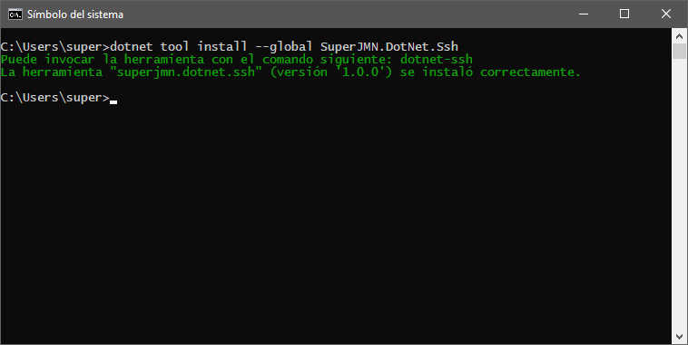
Creation of .NET Core Applications
App deployment
We will use a special tool for .NET Core designed to deploy to the Raspberry Pi
Install the tool inside a cmd shell with:
> dotnet tool install --global SuperJMN.DotNet.Ssh

Slide 51
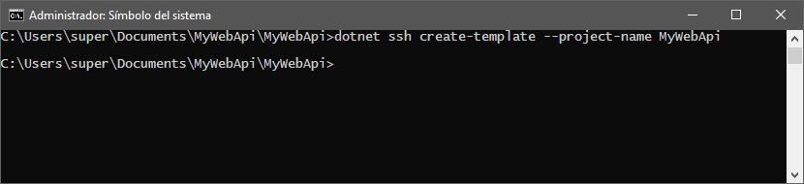
Creation of .NET Core Applications
With this tool we can deploy our .NET Core applications in the blink of an eye
Inside the root folder of the application, run the deploy tool with the create-template verb
* Important: you should run the command inside the folder that contains the project (.csproj)
> dotnet ssh create-template --project-name MyWebApi

Slide 52
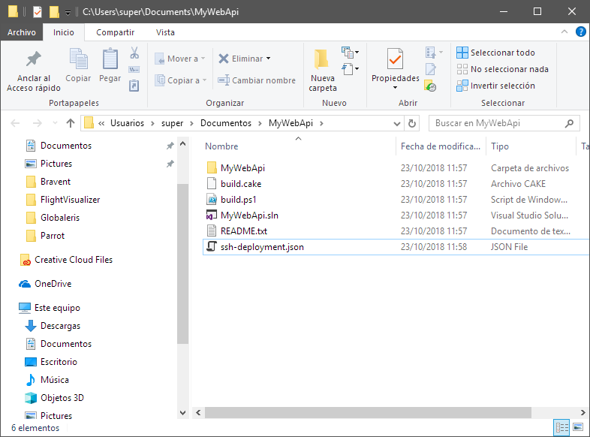
Creation of .NET Core Applications
A new file will be created inside your solution called “ssh-deployment.json”
It contains the data needed for the deployment of the application.

Slide 53
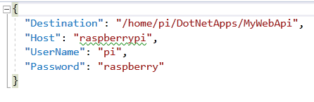
Creation of .NET Core Applications
ssh-deployment.json
You can configure:
The target directory (for the deployment)
the hostname of your Pi
Username and Password to connect to it
The default file has the predefined settings, but you may have to edit it so it fits your Raspberry Pi settings

Slide 54
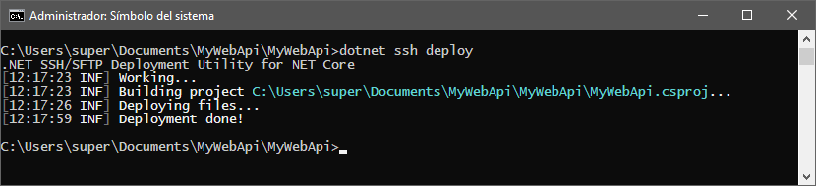
Creation of .NET Core Applications
Once we have verified configuration we can proceed with deployment
> dotnet ssh deploy

Slide 55
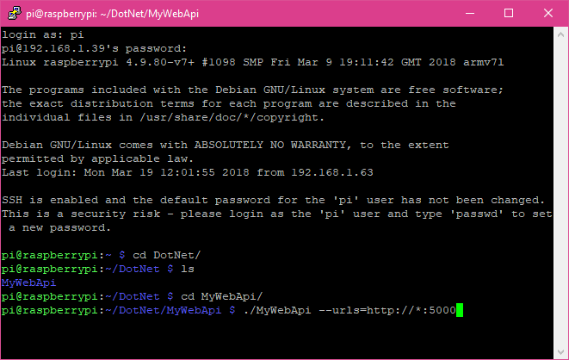
Creation of .NET Core Applications
The application will run exactly the same as the application we created before. But this application will include some nice extras:
Swagger comes preconfigured
A logger is implemented (Serilog)
And we can configure the urls that our server will listen to, that is quite handy.
Example:
./MyWebApi --urls=http://*:5000

Slide 56
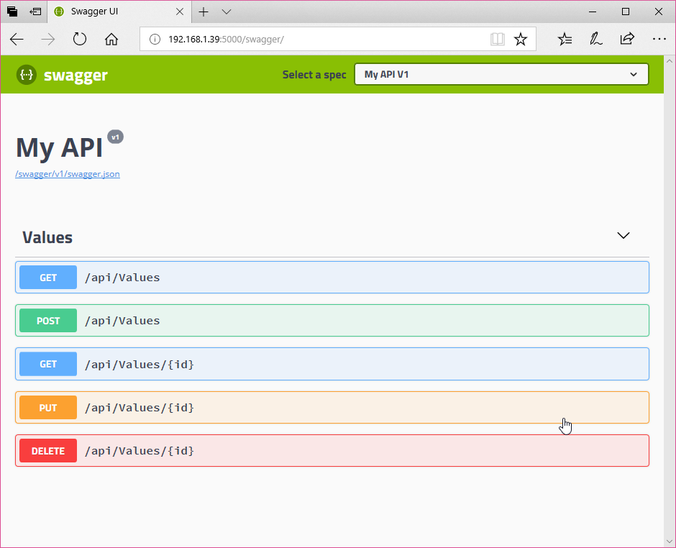
Creation of .NET Core applications
This way, the ASP.NET Core server will will server to any request coming to the 5000 port
We can then use a browser and see the entire API using Swagger
http://[ Rpi hostname ]:5000/swagger
This is the default API that is created by the template

Slide 57
Other tricks
It’s very interesting to learn how to make our the Raspberry PI run our application in background after booting, since servers need to be available as much time as it’s possible.
Running on boot
You can do this by editing /etc/rc.local
> sudo nano /etc/rc.local
Add this line to run our application (a server) in the background:
./home/pi/DotNet/MyWebApi/MyWebApi --urls=http://*:5000 &
It’s important to add the & character, since it’s a background service that you have to fork the execution to avoid lockups

Slide 58
Other tricks
In order for the Raspberry Pi to be reachable from the outside (Internet) we will need a static IP or a DDNS service. I recommend DuckDNS, that is a simple to and easy to use DDNS service.
In addition:
We need to open ports in our router. But this is another story, because every router has its own method 😫
It’s also very useful to learn how to use the crontab Linux tool to run our .NET Core applications in a timely (scheduled) fashion. It will make you able to run your applications according to a schedule specified by an expression.
For instance, you can use it for maintenance processes or bulk data importations
To create crontab expressions see this useful site: https://crontab.guru/

Slide 59
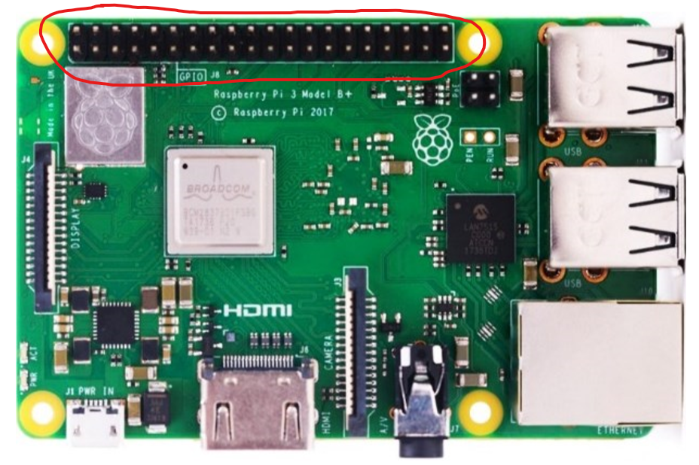
Extra: Working with GPIO
The Raspberry Pi has a set of pins that can be used to communicate with other hardware componentes via electronic signals.
This set of pins is called GPIO port.
And most importantly:
You can control it using .NET Core!

Slide 60
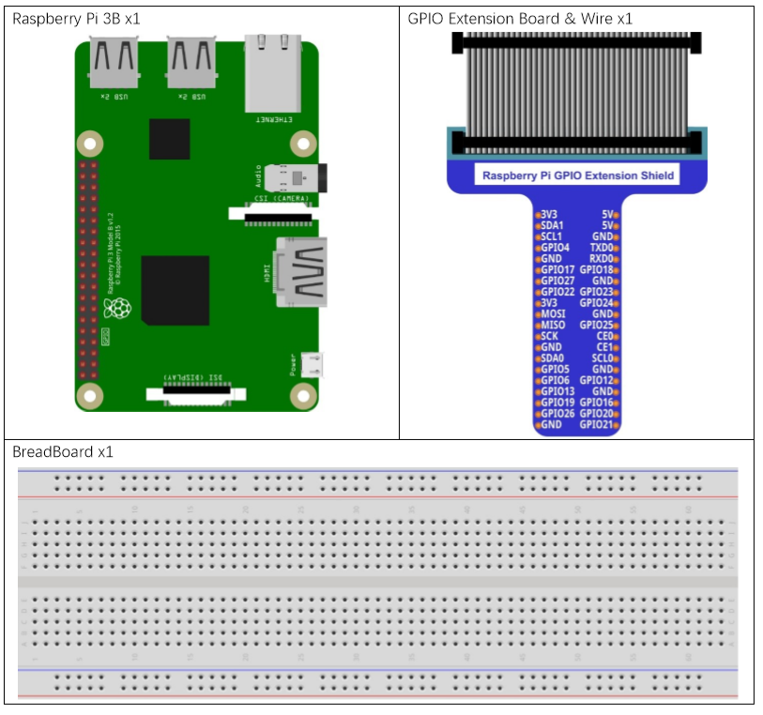
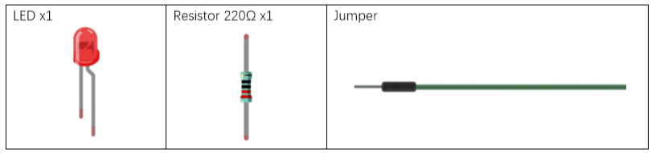
Basic IoT Circuit
I’ll be using a very nice starter kit (Freenove) as an example.
These are the components we need

Slide 61
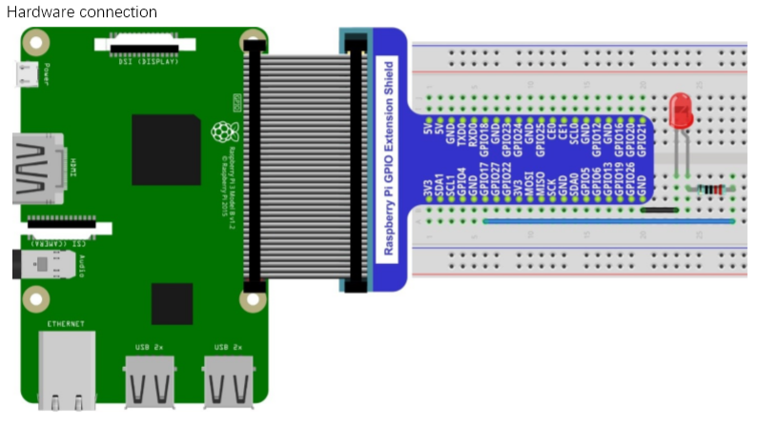
Basic IoT Circuit

Slide 62
Basic IoT Circuit
To work with the GPIO port we’ll be using a library called
Unosquare RaspberryPi IO
For more information, check their GitHub site
It contains valuable information and a lot of documentation / examples
Moreover, you will need to know how the pin numbering works in order to wire everything correctly 😉

Slide 63
Basic IoT Circuit
Show me the code!
class Program
{
static void Main(string[] args)
{
TestLedBlinking();
}
public static void TestLedBlinking()
{
var blinkingPin = Pi.Gpio.Pin00;
// Configure the pin as an output
blinkingPin.PinMode = GpioPinDriveMode.Output;
// perform writes to the pin by toggling the isOn variable
var isOn = false;
for (var i = 0; i < 30; i++)
{
isOn = !isOn;
blinkingPin.Write(isOn);
System.Threading.Thread.Sleep(500);
}
}
}
This is GPIO17

Slide 64
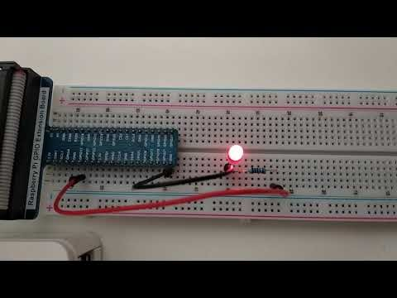
Basic IoT Circuit

Slide 65


Thank you!
T
Questions, requests?
jnieto@bravent.net
www.brintia.com
@superjmn

Slide 66

Upcoming webinars /
The Role of Chatbots in Customer Service Machine Learning
30 / 10 / 2018 at 17:00 (British hour)
14 / 12 / 2018 at 17:00 (British hour)

